Slide 1
Applied Physics NS (101)
LECTURE # 7
DATE: 3RD SEPTEMBER , 2019

Slide 2
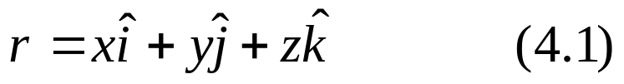
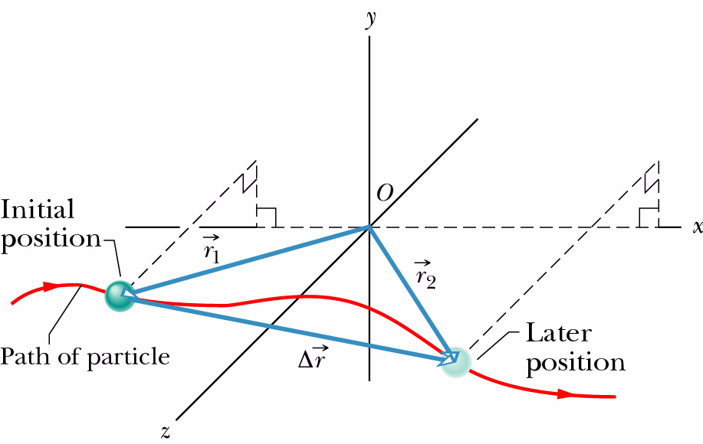
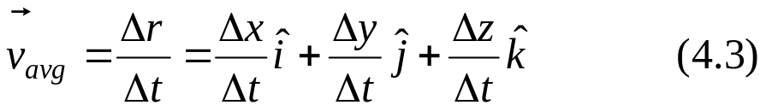
Motion in two/three dimensions
Position vector: extends from the origin of a coordinate system to the particle.
Displacement vector: represents a particle’s position change during a certain
time interval.
Average velocity:

Slide 3
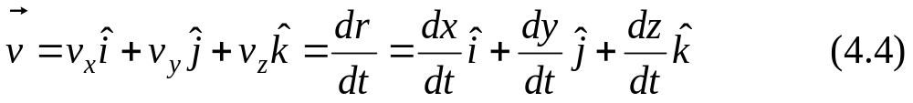
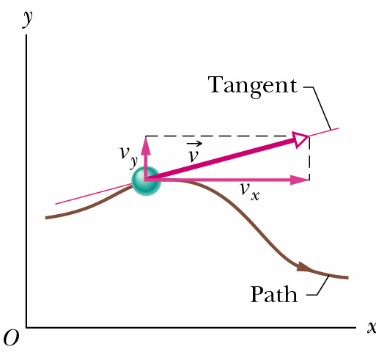
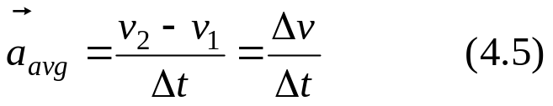
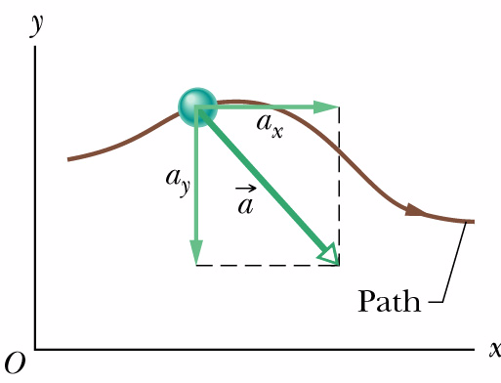
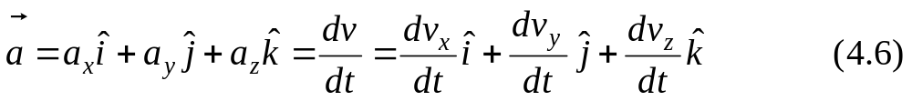
Instantaneous velocity:
The direction of the instantaneous velocity of a
particle is always tangent to the particle’s path at
the particle’s position
Average acceleration:
Instantaneous acceleration:

Slide 4
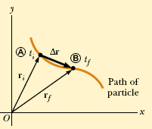





Motion in two dimension
THE DISPLACEMENT, VELOCITY, AND ACCELERATION VECTORS

Slide 5


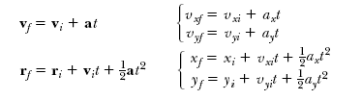

Slide 6

Free Fall and Gravitational Acceleration
A free-falling object is one which is falling under the sole influence of gravity. This definition of free fall leads to two important characteristics about a free-falling object:
  Free-falling objects do not encounter air resistance
  All free-falling objects (on Earth) accelerate downwards at a rate of -9.8 m/s²
    This rate is commonly referred to as g

Slide 7
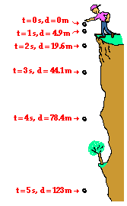
Free Fall and Gravitational Acceleration
All of the equations that work for HORIZONTAL (x-direction) motion ALSO work for VERTICAL (y-direction) motion.
Simply substitute g for a and Δy for Δx
Generally, free falling objects start falling from rest, so it tends to simplify the equations by eliminating v_{i}

Slide 8
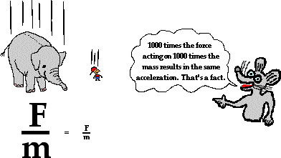
FREELY FALLING OBJECTS
A free-falling object is an object which is falling under the sole influence of gravity. Any object which is being acted upon only be the force of gravity is said to be in a state of free fall.
There are two important motion characteristics which are true of free-falling objects:
Free-falling objects do not encounter air resistance.
All free-falling objects (on Earth) accelerate downwards at a rate of 9.8 m/s/s

Slide 9
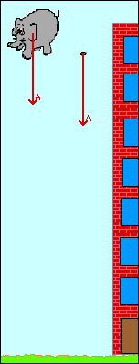



Slide 10
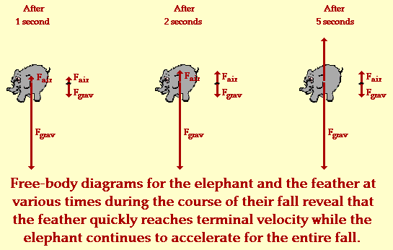

Slide 11
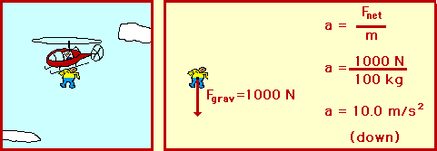
Terminal Velocity
Forces cause objects to accelerate (2nd Law).
When the force of gravity on a falling object equals the force of the air resistance going against gravity, the forces balance out and the object stops accelerating.
The object will travel at a constant velocity – the terminal velocity.

Slide 12
Q-1
The position of a particle moving in an XY direction is given by
r = { (2)t³ -(5)t }i + { (6)-(7t⁴) }j Calculate (a) r (b) v (c) a when t = 2sec.|
Ans: r = 6i -106j, v = 19i -224j , a= 24i -336j

Slide 13
Q-2
A particle had a velocity of 18 m/s in the +X direction and 2.4 sec later its velocity was 30m/s n the opposite direction. What was the average acceleration of the particle during this 2.4sec interval ?
Ans: -20m/s

Slide 14
Q-3
A rocket ship in free space moves with constant acceleration equal to 9.8 m/s² (a) if it starts from rest, how long will it take to acquire a speed one – tenth that of light? (b) How far will it travel in so doing? ? (The speed of light is 3x 10⁸ m/s).
Ans: t = 3.1 x 10⁶ sec , s = 4.7 x 10¹³ m

Slide 15
Q-4
At a construction site a pipe wrench strikes the ground with a speed of 24m/s (a) From what height was it inadvertently dropped? (b) For how long was it falling?
Ans: s = 29.38 m , t= 2.448sec

Slide 16
Q-5
A ball thrown straight up takes 2.25 sec to reach a height of 36.8m (a) What was its initial speed ? (b) What is its speed at this height? (c) How much higher will the ball go?
Ans: 27 m/s , 5.25 m/s , 1.45m

Slide 17
Q-6
A particle moves along the x axis according to the equation x = 50 t +10 t²,
where x is in meters and t is in seconds. Calculate (a) the average velocity of the particle during the first 3 sec of its motion,
(b) the instantaneous velocity of the particleat t = 3 sec, and
(c) the instantaneous acceleration of the particle at t =3sec.
(Ans: 80 m/s , 110 m/s , 20m/s²)

